Slide 1
Contest of Argonauts
Turk Bekcioglu

Slide 2
Mechanics: Drafting
Heroes:
Stats:
Attack
Defense
Speed
HP
Range
Damage
Skills
Passives
Ultimate Ability

Slide 3
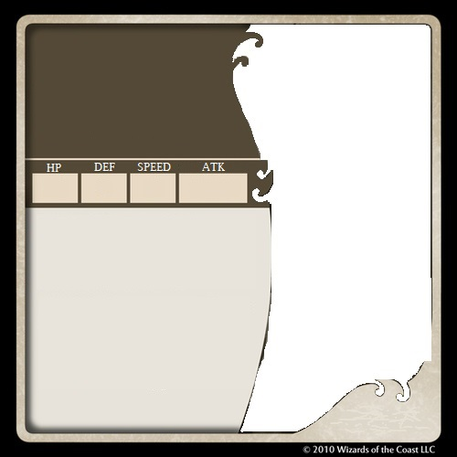

Name
Background
Pendragon
Power: Crusader
A strong believer of justice, honor, and the glory of battle, her Power, Crusader, allows her to create an aura to aid and protect her allies and punish evildoers who dare attempt to harm them.
8
13
5
+3
8
13
5
+3
Skill 1:
Skill 2:
Judgment - Next attack that hits deals +1 damage if the target has damaged an ally this round. [1BP]
Empower - Target ally within 3 spaces has advantage until the end of their next turn. [2 BP]
🜲
🜲 Bolster the Army -
All allies within 2 spaces have advantage and all enemies have disadvantage until end of their next turn. [4BP]
🜳
🜳 Guardian’s Flight- If an ally is at 2 or less HP, fly to the closest unobstructed space. (replaces move)
Damage:2 Range:X
Damage:3 Range:1

Slide 4


Iron Rebel
Power: Armament
About as hard-headed and stubborn as they get, his Power allows him to reinforce his body with steel. Surprisingly he prefers classical music to metal,
Ferocity
Power: Overheat
Hotheaded both figuratively and literally, her Overheat power allows her to convert parts of her body into fire reaching temperatures of up to 400℃. Her hair tends to combust when angered.
7
14
5
+2
8
11
5
+2
Armor Spike - Next time an enemy damages you they take 2 damage. (lasts until start of next turn) [2BP]
Iron Defense - As a reaction when an enemy attacks, raise DEF by 2. [2BP]
Explosion - Next attack deals damage to all enemies within 2 spaces of target (roll separately for each) [3BP]
Ignition - Next attack has range 5 and has chance to burn enemies next to target on roll of 12+ [1BP]
🜲 Panzer Strike - Deal damage to 5 spaces in front of you, all enemies within are inflicted with stun this attack also has breakthrough [5BP]
🜲 Hellfire - Until end of next turn Damage increased to 3 and chance of burn (from all abilities) decreased to roll of 5+ [5BP]
🜳 Unbreakable - If HP is greater than 1 any damage that would kill him instead brings him to 1 HP.
🜳 Immolate - All direct attacks have a chance to burn an enemy on a roll of 12+
Damage:2 Range:1
Damage:2 Range:2

Slide 5
Gameplay : How to Play
Game Start
Choose Teams
Match Start
Swap Characters
Choose Captain
Round Start
Reset and Increment BP
Turn Start
Movement Phase
Skill Phase
Attack Phase
Winning

Slide 6
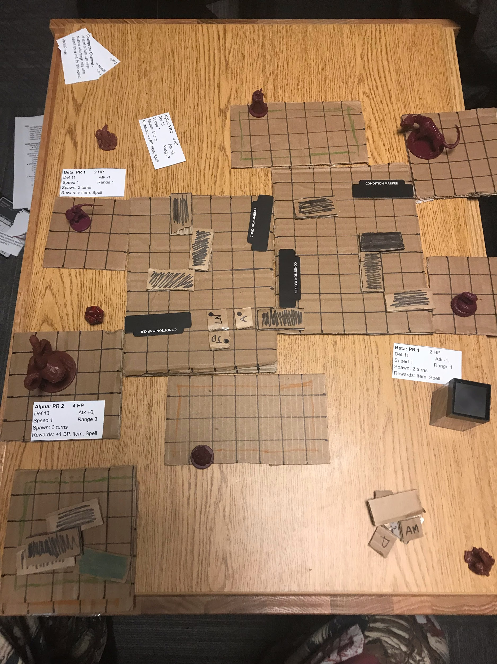
Old Map

Slide 7
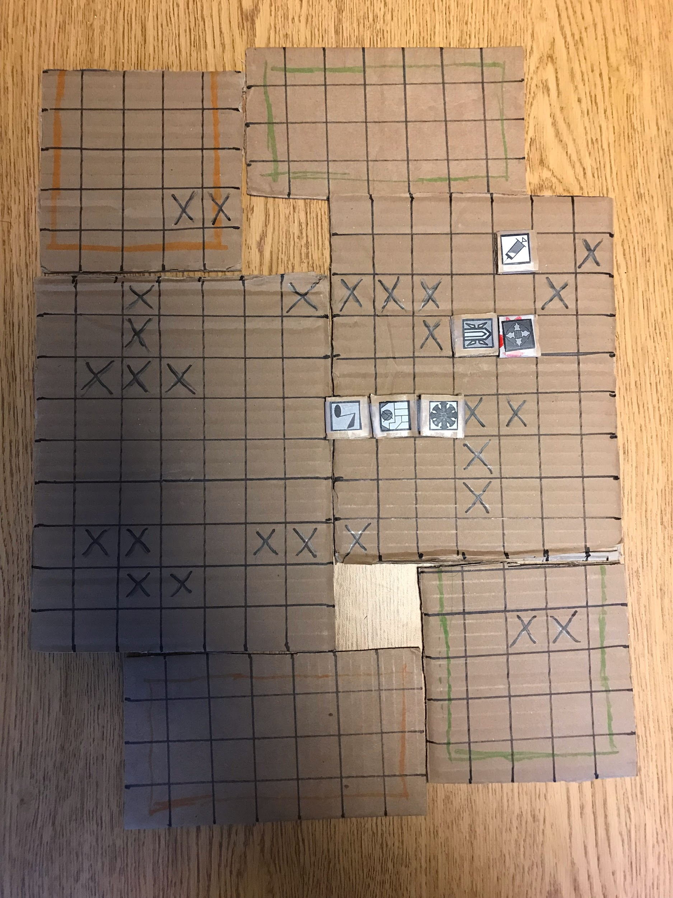
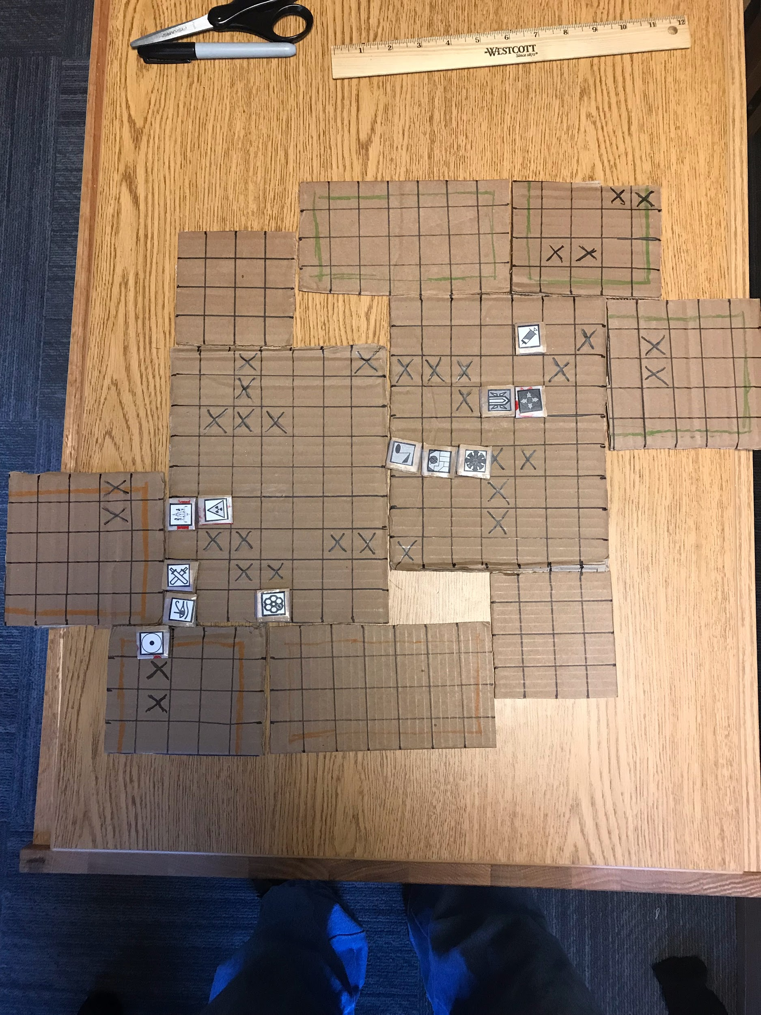
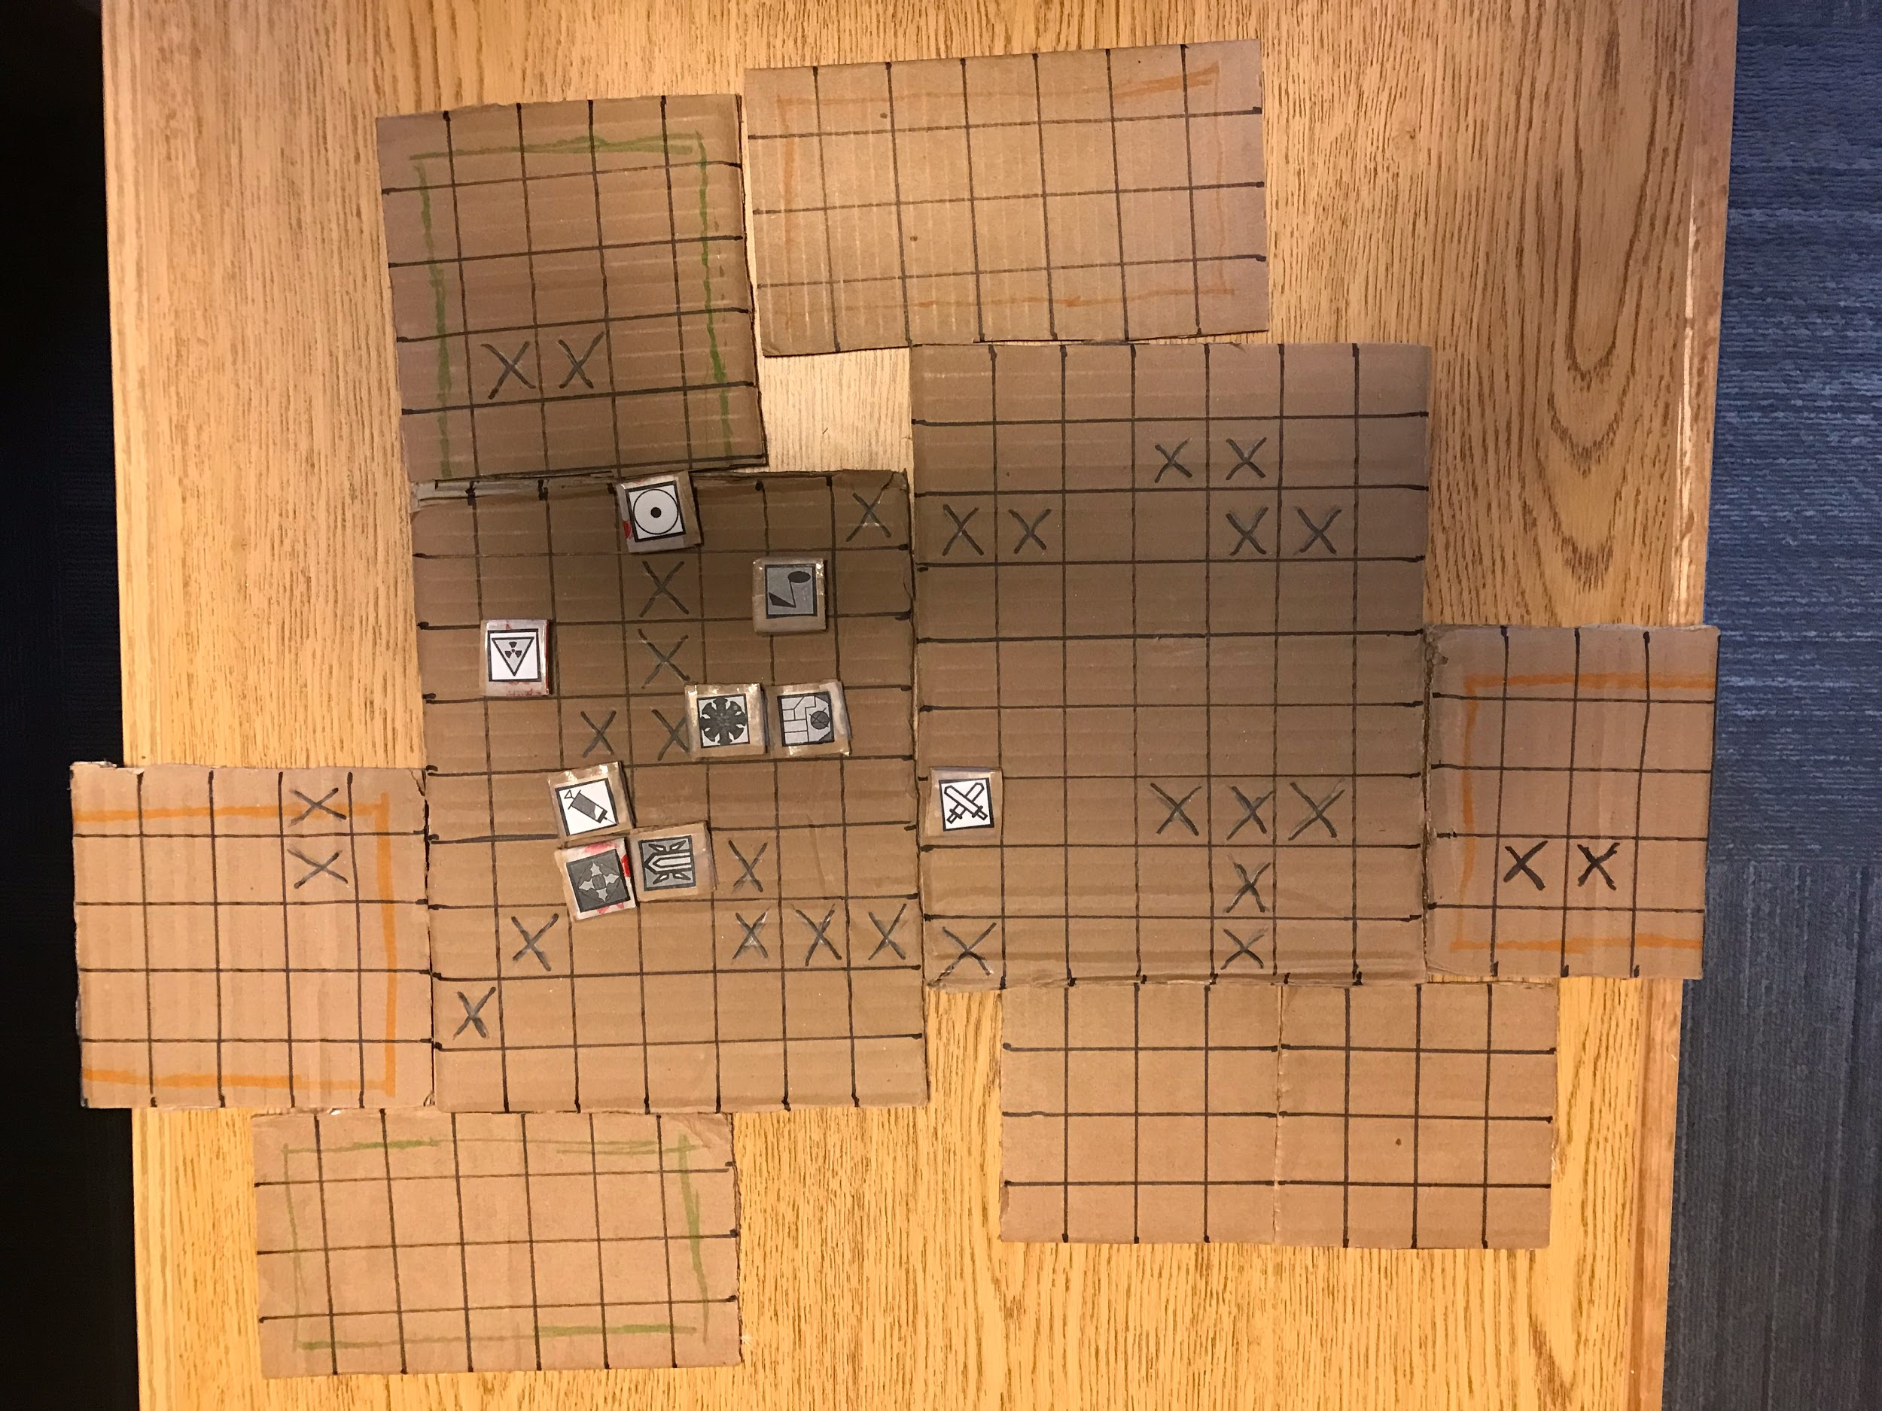
Map: Number of Players
4 Player
3 Player
2 Player

Slide 8
Questions?

